Slide 1
5 Useful Plots for Data Scientists

Slide 2

Agenda
Introduction
Chord Diagram
Sunburst Chart
Hexbin Plot
Sankey Diagram
Stream or Theme River Graph
Conclusion

Slide 3

Introduction
The plots aim to enhance our comprehension of data by enabling smooth interaction between the data and its graphical representation. It achieves this by combining our data with relevant metadata, ensuring that both the raw data and its visualization are easily accessible. This approach may differ from conventional data-processing and plotting tools, and the purpose of this introductory guide is to provide a comprehensive overview of its functionality.

Slide 4
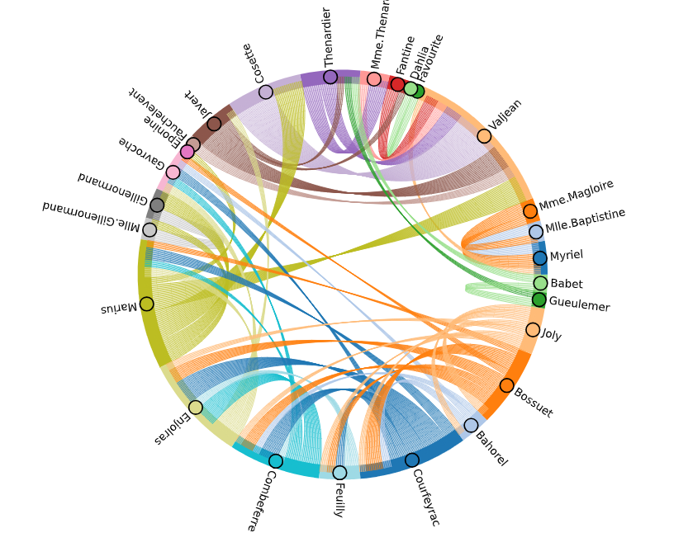
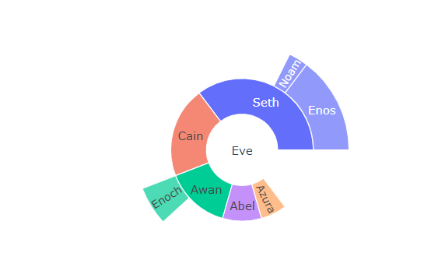
1. Chord Diagram
2. Sunburst Chart
The Chord element is a graphical representation of the connections between data points. It arranges the nodes in a circular pattern and uses arcs or chords to depict the relationships between them. The number of chords is determined by a weight, which is specified as a value dimension for the Chord element.
Used in areas like:
Social networks
Genomics data
Traffic flow data
Trade-related data
Sunburst diagrams are suitable for visualizing hierarchical data in scenarios like:
Organizing file systems
Mapping website navigation paths
Analyzing market segmentation
Displaying genomic data
Plotly Express simplifies the process of creating a Basic Sunburst Plot, offering a user-friendly interface that can handle different types of data and generate visually appealing figures.

Slide 5
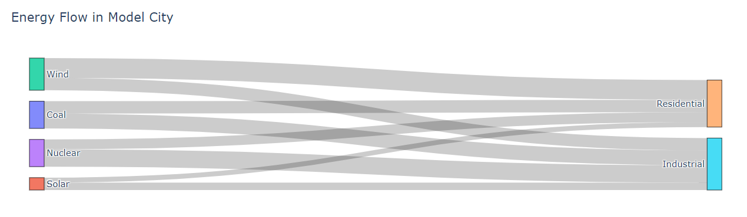
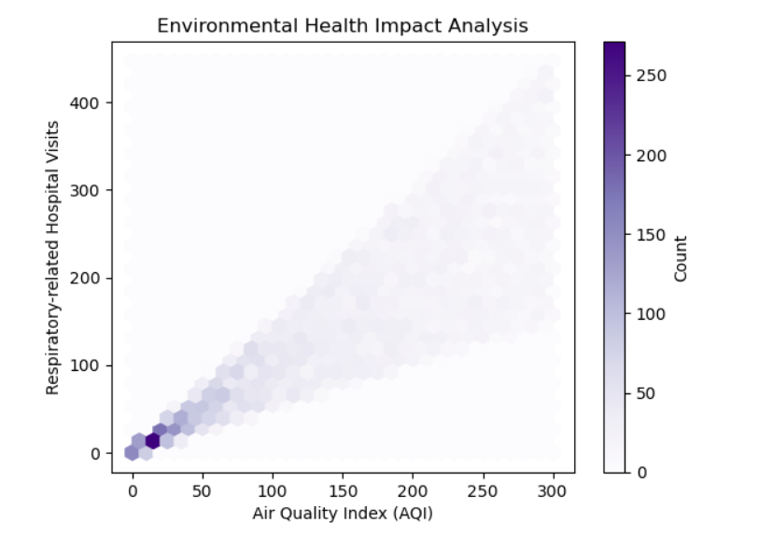
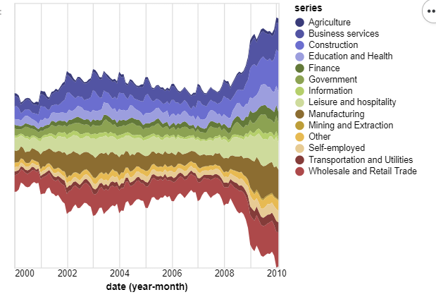
3. Hexbin Plot
4. Sankey Diagram
This Hexbin plot is designed in 2D, utilizing hexagons as bins with varying colors to represent the quantity of data points within each bin.
This type of plot is ideal for analyzing the connection between two sets of data (Bivariate data). It serves as a useful alternative to Scatter plots, especially when dealing with a large dataset
A Sankey Diagram comprises Nodes and connections linking them. Used in:
Supply chain and logistics data
Traffic flow data
Data flow
Energy flow data
5. Stream / River
The plot serves as a useful tool for visualizing various types of Time series data, including:
Popularity trends
Financial data
Website traffic data
Sales/ Marketing data

Slide 6
Conclusion
The framework offered allows for :
the thorough examination,
interpretation, and
extraction of valuable insights from intricately interconnected data.
This empowers us to comprehend connections, make well-informed choices, enhance processes, and effectively tackle intricate issues across diverse fields.

Slide 7


Thank You
dSights is a data tech specialist with a vision to create value through:
Outcome-Oriented AI
Fueled by
Innovative Experimentation

